Slide 1
AUTOMATIC TEMPERATURE VOICE ALARM SYSTEM
For the course Advanced Hardware Design
Prepared under the guidance of Dr. Yuhua Chen
By
Kevin Shah
Ray Xing
Dharmik Sutaria

Slide 2
Objective
Is to develop a system using Arrow SoCKit board which continuously measure the temperature of the board and play a prerecorded audio as a warning alarm if the temperature exceeds certain value.
An optical display like a thermometer has a limited affectivity since it can be easily overlooked. A voice alert on the other hand is not easy to ignore.

Slide 3
Introduction
In certain application an automatic system is required to monitor the temperature continuously.
When the current temperature is within the desired range, no control action is needed.
But when temperature exceeds certain range a prerecorded audio clip will be played as an alert to the users.
The current temperature of the board must be continuously displayed.

Slide 4
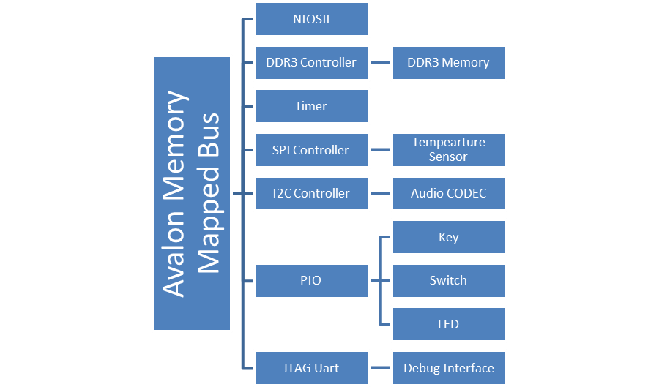
System Architecture

Slide 5
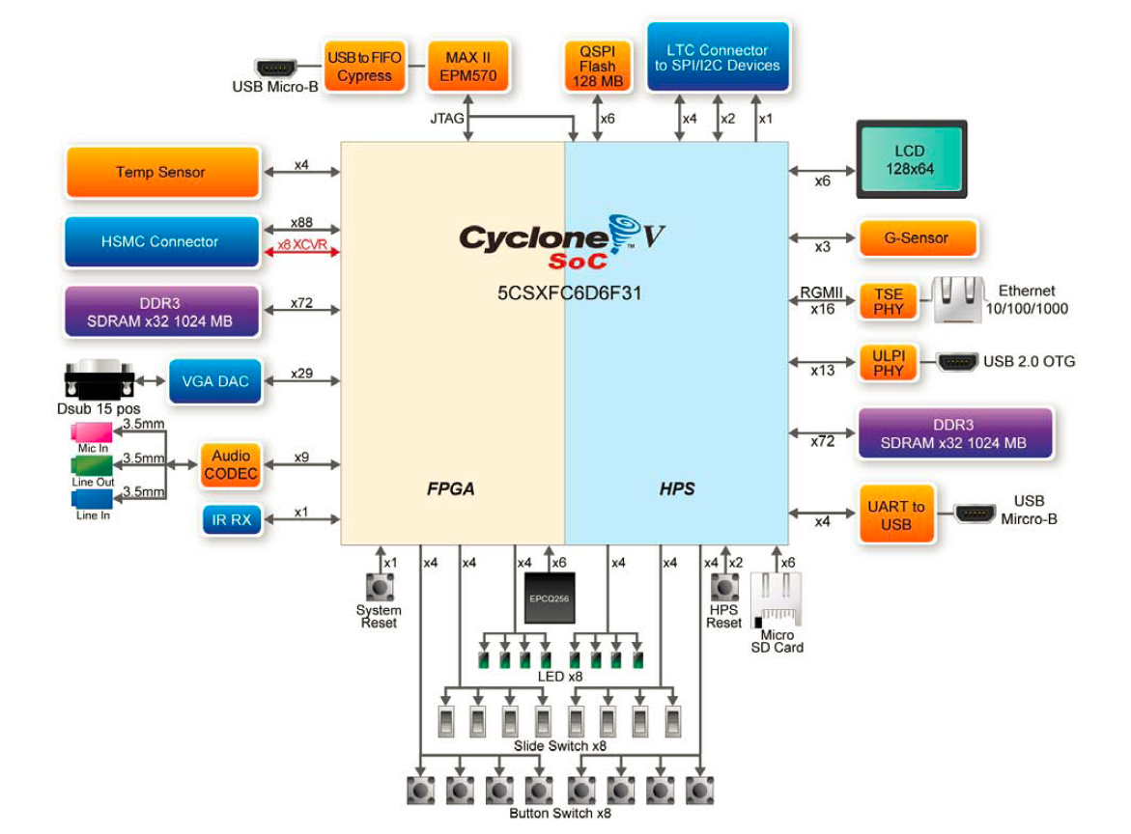

Slide 6
Software Hierarchy
User Application
Hardware Abstraction Layer
Hardware API
Hardware

Slide 8


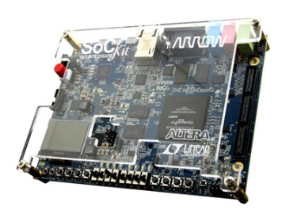

Basic Topology of the System
An alert message is prerecorded
Temp. sensor monitors and displays temp. continuously
An alert signal is generated when temp.
exceeds certain range.

Slide 9
Future Development
Connect an automatic dialer to the system, so if the temperature is too high it will automatically dial a number.
Interface a keyboard so that user can change the range of temperature in the field i.e. field programmable.
Send the alert via text messaging.

Slide 10
Applications
In industries where temperature sensitive equipments are used.
In Cold storage and Server Rooms.
In Blood and medical stores.
In Energy Conservation.
In active Green houses.
In Phone or wiring closets.
In large computer rooms or data centers.

